Slide 1
Shared Memory
Share with me

Slide 2
Shared Memory : Features of shared Memory
Best suited when need large amount data to share.
Allows multiple unrelated and related process to access.
Very efficient way of transferring data.
We can read data in many times.
Max no of shared segments we can use is 4096
Over written problem.
It doesn’t have in built synchronization facility.

Slide 3
Shared Memory : representation of shared Memory
Logical address space of A
Physical Memory
Logical address space of B
Shared Memory

Slide 4
Shared Memory : Where shared Memory Placed
Global vars
Stack
shared memory
Heap

Slide 5
Shared Memory : Messaging shared Memory
Key 1243
shared memory region
Process A
Process B
A
B

Slide 6
System Calls related to Shared Memory

Slide 7
Shared Memory : shmget
int shmget( ket_t key, /*Returns shared memory id */
size _t size ,
int shmflag );
key ------------------ Arbitrary number
size ----------------- Amount of memory required
shmflag
IPC_PRIVATE
IPC_CREAT
IPC_EXCL

Slide 8
Shared Memory : shmat
void *shmat( int shmid, /*Attaching shared memory */
const void *shm_addr,
int shmflag );
shmid ------------ Shared memory id return by shmget()
shm_addr --------- Address at which memory to be attached
shmflag
SHM_RND
SHM_RDONLY
Notes:
If shmaddr = NULL,the system chooses a suitable (unused) address at which to attach the segment
If shmaddr isn't NULL and SHM_RND is specified in shmflg, the attach occurs at the address equal to shmaddr rounded down to the nearest multiple of SHMLBA. Otherwise shmaddr must be a page-aligned address at which the attach occurs
If SHM_RDONLY is specified in shmflg, the segment is attached for reading and the process must have read permission for the segment. Otherwise the segment is attached for read and write and the process must have read and write permission for the segment. There is no notion of a write-only shared memory segment.
Return Value
On success shmat() returns the address of the attached shared memory segment; on error (void *) -1 is returned, and errno is set to indicate the cause of the error.

Slide 9
Shared Memory : shmctl
int shmctl( int shmid, /*Control function */
int cmd,
struct shmid_ds *buf );
shmid ------ shared memory id return by shmget()
cmd
IPC_STAT
IPC_SET
IPC_RMID
buf ----------- Modes and other fields

Slide 10
Shared Memory : Members of buf
struct shmid_ds {
struct ipc_perm shm_perm; /* operation perms */
int shm_segsz; /* size of segment (bytes) */
time_t shm_atime; /* last attach time */
time_t shm_dtime; /* last detach time */
time_t shm_ctime; /* last change time */
unsigned short shm_cpid; /* pid of creator */
unsigned short shm_lpid; /* pid of last operator */
short shm_nattch; /* no. of current attaches */
/* the following are private */
unsigned short shm_npages; /* size of segment (pages) */
unsigned long *shm_pages; /* array of ptrs to frames -> SHMMAX */
struct vm_area_struct *attaches; /* descriptors for attaches */
};
Notes:
shm_perm This is an instance of the ipc_perm structure, which is defined for us in linux/ipc.h. This holds the permission information for the segment, including the access permissions, and information about the creator of the segment (uid, etc).
shm_segsz Size of the segment (measured in bytes).
shm_atime Time the last process attached the segment.
shm_dtime Time the last process detached the segment.
shm_ctime Time of the last change to this structure (mode change, etc).
shm_cpid The PID of the creating process.
shm_lpid The PID of the last process to operate on the segment.
shm_nattch Number of processes currently attached to the segment.

Slide 11
Shared Memory : shmdt
int shmdt( const void *shmaddr ) /*Detaching shared memory*/
shmdt() detaches the shared memory segment located at the address specified by shmaddr from the address space of the calling process

Slide 12
Shared Memory : Sample Program
/*Data */
struct data {
char record[20];
} *shm_snd,*shm_rcv ;
/*Creating Shared Memory */
#include<sys/shm.h>
int shmid;
if ((shmid=shmget (10, sizeof(struct data), IPC_CREAT|0666))= = -1)
{
perror (“error”);
exit(0);
}
/* Attaching Shared Memory */
shm_snd= (struct data *) shmat(shmid, 0, 0);
shm_rcv= (struct data *) shmat(shmid, 0, 0);
/* Sending and receiving data */
printf(“ Enter data \n” );
scanf(“ %s”,shm_snd->record);
printf(“ Reading data from shared memory \n”);
printf(“ * * %s * * \n”,shm_rcv->record);

Slide 13
Shared Memory : Sample Program contd..
/* Detaching Shared Memory */
shmdt (shm_snd);
shmdt (shm_rcv);
/* Removing Shared Memory */
shmctl(shmid, IPC_RMID, 0);
Shared Memory : Output
Enter data
Welcome to Mirafra
Reading data from shared memory
* * Welcome to Mirafra * *

Slide 14
Shared Memory : Summary
Advantage and disadvantages of shared memory
large amount of data can share
Data can be read many times
Multiple processes can access shared segment
Synchronization is required for Shared memory
Over written problem

Slide 15

Semaphores
Security guards
Notes:
they are counters used to provide controlled access to shared data structures for multiple processes.

Slide 16
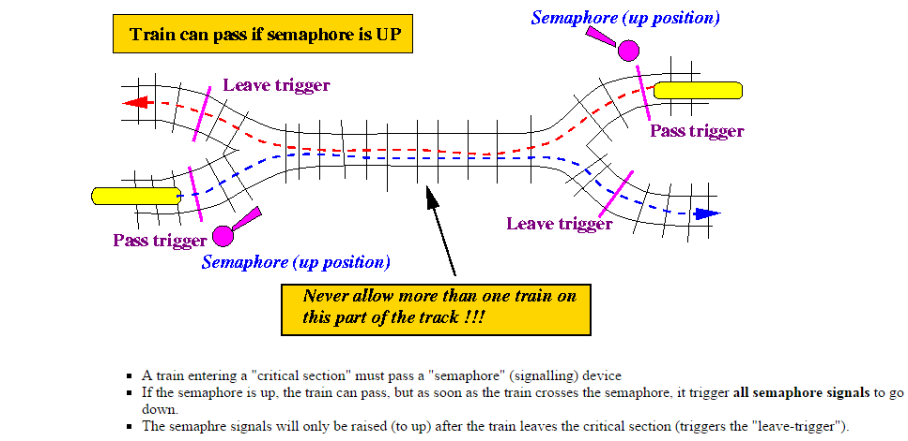
Semaphore : Analogy

Slide 17
Shared Memory : Properties of semaphores
Semaphore is a special variable which allow only two
operations wait and signal.
Used to implement synchronization and critical region
in multi process system.
Different semaphores are available, based on our
application we can use any one of them.
When process dies all its related semaphores revert their
values (when using option SEM_UNDO)
Notes:
The semaphore value is positive if the protected resource is available, and 0 if the protected resource is currently not available. A process that wants to access the resource tries to decrease the semaphore value; the kernel, however, blocks the process until the operation on the semaphore yields a positive value. When a process relinquishes a protected resource, it increases its semaphore value; in doing so, any other process waiting for the semaphore is woken up

Slide 18

Process A execution
Process B execution
Check for Semaphore
If available only one can Enter
Non critical section of A
Critical section
Non critical section of B
Release Semaphore

Slide 19
System Calls related to Semaphores

Slide 20
semget
int semget( key_t key,
int num_sems,
int sem_flags
);
key ---------- An arbitrary number (IPC_PRIVATE)
num_sems --------- Number of semaphores required
sem_flags
IPC_CREAT
IPC_EXCL

Slide 21
semop
int semop( int semid, struct sembuf *sem_ops,
size_t num_sem_ops
) ;
semid ------- Semaphore id return by semget()
sem_ops ------- Which is pointer to an array of structures
num_sem_ops ------- Size of structure pointed by sem_ops pointer
Notes:
semop() function is used to perform atomically an array of semaphore operations on the set of semaphores associated with the semaphore identifier specified by semid

Slide 22
sembuf structure
/ * sembuf structure * /
struct sembuf { short sem_num;
short sem_op;
short sem_flg;
};
sem_num semaphore number
sem_op value on which semaphore should be changed
sem_flg SEM_UNDO or ZERO

Slide 23
Taking Semaphore ( Wait )
If sv is greater than zero decrement sv
else
suspend execution of this process
Releasing Semaphore ( Signal )
Increment sv and if some other process has suspended waiting for sv make it resume execution
else
increment sv and continue its execution

Slide 24
semctl
int semctl( int semid,
int sem_num ,
int command ,
…
)
semid --------- Semaphore id return by semget()
sem_num --------- Semaphore number
command --------- Which action to do
… parameter --------- If need it is a union of different fields

Slide 25
Creating Semaphore
int main()
{
int sid;
sid = semget( 1 , 1 , IPC_CREAT|0666);
if(sid == -1)
printf("Unable to create semaphore \n");
else
printf("Semaphore created successfully \n");
system("ipcs");
return 0;
}

Slide 26
Set Semaphore Value
int main()
{ int sid;
union semun semunion;
semunion.val = 1;
sid = semget(1,1,IPC_CREAT|0666);
if(semctl(sid,0,SETVAL,semunion) == -1)
printf("Unable to set value \n");
return 0;
}
union semun
{ int val;
struct semid_ds *buf;
unsigned short int *array;
struct seminfo *info;
};

Slide 27
Using Semaphore
int main()
{
sid = semget(1,1,IPC_CREAT|0666);
take_semaphore();
critical_section();
release_semaphore();
return 0;
}

Slide 28
Take Semaphore
void take_semaphore()
{
struct sembuf semb;
semb.sem_num = 0;
semb.sem_op = -1;
semb.sem_flg = SEM_UNDO;
if(semop( sid , &semb , 1) == -1)
printf("Unable to Take Semaphore \n");
}

Slide 29
Critical Section
void critical_section()
{
printf("Process with PID = %d ",getpid());
printf(“is entering Critical Section\n”);
sleep(5);
// exit(0);
printf("Process with PID = %d ",getpid());
printf(“is leaving Critical Section\n”);
}

Slide 30
Give Semaphore
void release_semaphore()
{
struct sembuf semb;
semb.sem_num = 0;
semb.sem_op = 1;
semb.sem_flg = SEM_UNDO;
if(semop( sid , &semb , 1) == -1)
printf("Unable to Take Semaphore \n");
}

Slide 31
Set Semaphore Value
int main()
{ int sid;
union semun semunion;
semunion.val = 1;
sid = semget(1,1,IPC_CREAT|0666);
if(semctl(sid,0,SETVAL,semunion) == -1)
printf("Unable to set value \n");
return 0;
}
union semun
{ int val;
struct semid_ds *buf;
unsigned short int *array;
struct seminfo *info;
};

Slide 32
Delete Semaphore
int main()
{
int sid;
sid = semget(1,1,IPC_CREAT|0666);
if(semctl( sid , 0 , IPC_RMID , 0) == -1)
printf("Unable to Delete Semaphore \n");
system("ipcs");
return 0;
}

Slide 33
Sample Program
/* Sample program with Pipes and Semaphores*/
/* Data */
struct message{
char record[12];
}p_snd,p_rcv ;
/* Creating Pipe and Initiating fork() */
int pid, p[2];
pipe(p);
pid=fork();
printf(“Using descriptors are:%2d %2d \n”,p[0],p[1] );

Slide 34
/* Creating Semaphore*/
#include<sys/sem.h>
struct sembuf semb;
int semid;
if(semid=semget(10,0,IPC_CREAT|0666))==-1)
{
perror(“Error”);
exit(0);
}
/* Set value to Semaphore */
semctl (semid,0,SETVAL,1);
/*writing data into pipe in parent */
int i;
if(pid!=0) {
semb.sem_num=0;
semb.sem_op=-1;
semb.flag=0;
semop(semid,&semb,1); / *LOCKED */

Slide 35
for( i =1; i<4; i++)
{
printf(“ Enter Different Strings \n” );
scanf(“%s”,p_snd.record);
write(p[1] ,&p_snd, sizeof(struct record))
}
semb.sem_num=0;
semb.sem_op=1;
semb.flag=SEM_UNDO;
semop(semid,&semb,1);
} /*RELEASED*/

Slide 36
/* Receiving data in child process */
else {
sleep(2);
semb.sem_num=0;
semb.sem_op=-1;
semb.flag=0;
semop(semid,&semb,1); /*LOCKED */
for( i =1; i<4; i++)
{
read(p[0], &p_rcv, sizeof(struct record)) ;
printf(“Received data is: %s \n“,p_rcv.record);
}
semb.sem_num=0;
semb.sem_op=1;
semb.flag=SEM_UNDO; / * Automatically RELEASED */
}

Slide 37
Difference b/w Mutex and Binary Semaphore
Mutex follows locking mechanism. | Semaphore follows signalling mechanism.
The process which holds the lock that process only can unlock the mutex So, mutex holds the ownership of the lock. | The process may acquired the semaphore but semaphore can be released for the high priority process. So, this won’t follow ownership mechanism.
Mutex cannot have counter because its an object | Semaphore can have counting variable
CPU time will be wasted | CPU time will not be wasted
Power also wasted | Power also not wasted
Mutex can be used for process or thread based on requirement | Semaphore can be used for process or thread based on requirement

Slide 38
Thank you…

